Slide 1
Time Planning and Control Activity on Arrow (Arrow Diagramming Method)

Slide 2
Processes of Time Planning and Control
Visualize and define the activities.
Sequence the activities (Job Logic).
Estimate the activity duration.
Schedule the project or phase.
Allocate and balance resources.
Compare target, planned and actual dates and update as necessary.
Control the time schedule with respect to changes.

Slide 3
ARROW DIAGRAM
Each time-consuming activity (task) is portrayed by an arrow.
The tail and head of the arrow denote the start and finish of the activity whilst its duration is shown in brackets below.
The length of the arrow has no significance neither has its orientation.
Order and deliver the new machine
Activity
] Duration]
] 30]

Slide 4
ARROW DIAGRAM
As means of further defining the point in time when an activity starts or finishes, start and finish events are added.
An event (= node = connector), unlike an activity, does not consume time or resources, it merely represents a point in time at which something or some things happen.
Numbers are given to the events to provide a unique identity to each activity.
The first event in a project schedule is the start of the project. The last event in a project schedule is the end of the project.

Slide 5
Activity Identification
Start Event
Finish Event
10
Activity
20
[Duration]
Activity identification numbers
called event numbers

Slide 6
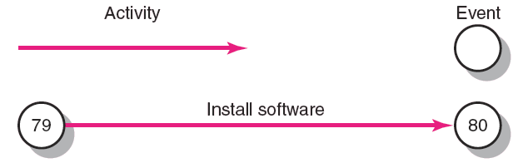
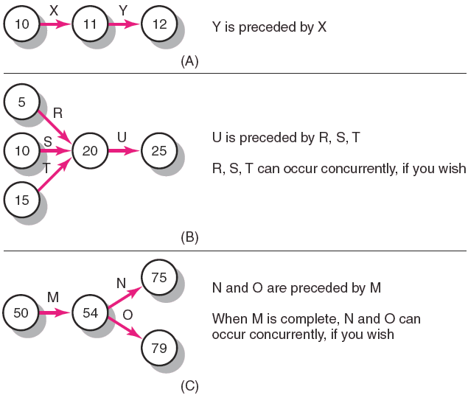

Slide 7
i-j Numbers of Events
i
j
Activity
Duration
The node at the tail of an arrow is the i-node.
The node at the head of an arrow is the j-node

Slide 8
Rules of Making Arrow Diagram
The network (the graphical representation of a project plan) must have definite points of beginning and finish.
(The accuracy and usefulness of a network is dependent mainly upon intimate knowledge of the project itself, and upon the general qualities of judgment and skill of the planning personnel.)
The arrows originate at the right side of a node and terminate at the left side of a node.
Any two events may be directly connected by no more than one activity.
Use symbols to indicate crossovers to avoid misunderstanding.

Slide 9
Logical Relationships
10
A
20
B
30
Node “20” is the j-node for activity “A” and it is also the i-node for activity “B” then activity “A” is a predecessor to activity “B”.
In other words activity “B” is a successor to activity “A”.
Activity B depends on activity A.

Slide 10
Logical Relationships
Succeeding activities
30
10
20
40
50
Event numbers must not be duplicated in a network.
j-node number greater than i-node number.

Slide 11
Logical Relationships
Concurrent activities
80
180
120
170
190
160

Slide 12
Rules of Making Arrow Diagram
The network must be a logical representation of all the activities. Where necessary, "dummy activities" are used for:
Unique numbering and
Logical sequencing.
Dummy activity is an arrow that represents merely a dependency of one activity upon another. A dummy activity carries a zero time. It is also called dependency arrow.

Slide 13
Dummy Activities
The following network shows incorrect activity numbering.
90
A
50
70
80
100
B
110
60

Slide 14
Dummy Activities
For unique numbering, use dummies.
75
90
A
50
70
80
100
B
110
60

Slide 15
Dummy Activities
For representing logical relationships, you may need dummies.
10
30
50
70
90
110
20
40
60
80
100
120

Slide 16
Rules of Making Arrow Diagram
There must be no "looping" in the network. The loop is an indication of faulty logic. The definition of one or more of the dependency relationships is not valid.
90
100
120
130
110

Slide 17
Rules of Making Arrow Diagram
The network must be continuous (without unconnected activities).
30
60
100
10
20
50
90
120
40
70
110
80

Slide 18
Rules of Making Arrow Diagram
Networks should have only one initial event and only one terminal event.
30
60
10
20
50
90
120
40
70
110

Slide 19
Rules of Making Arrow Diagram
Before an activity may begin, all activities preceding it must be completed (the logical relationship between activities is finish to start).

Slide 20
Network Analysis (Computation)
Occurrence times of Events = Early and late timings of event occurrence = Early and late event times
Earliest
Event
Time
Activity
Activity
Event
Label
Latest
Event
Time
Head
Tail
Standard layout for recording data

Slide 21
Early Event Time (EET = E =T_{E})
Early Event Time (Earliest occurrence time for event) is the earliest time at which an event can occur, considering the duration of precedent activities.
Forward Pass for Computing EET
Each activity starts as soon as possible, i.e., as soon as all of its predecessor activities are completed.
Direction: Left to right, from the beginning to the end of the project
Set: EET of the initial node = 0
Add: EET_{j} = EET_{i} + D_{ij}
Take the maximum
The estimated project duration = EET of the last node.
EET_{i}
Activity
EET_{j}
i
j
D_{ij}

Slide 22
Early Event Times (EET = E =T_{E})
0
3
4
12
10
20
30
40
A
B
C
3
1
8

Slide 23
Early Event Times (T_{E})
4
K
40
4
15
L
24
70
80
9
50
12
M
5

Slide 24
Early Event Times (T_{E})
20
50
3
2
3
4
10
30
70
4
5
7
60
3
40
1

Slide 25
Early Event Times (T_{E})
20
2
8
50
3
2
3
4
10
4
0
30
16
70
4
5
9
7
60
3
40
3
1

Slide 26
Late Event Time (LET = L =T_{L})
Late Event Time (Latest occurrence time of event) is the latest time at which an event can occur, if the project is to be completed on schedule.
Backward Pass for Computing LET
Direction: Right to left, from the end to the beginning of the project
Set: LET of the last (terminal) node = EET for it
Subtract: LET_{i} = LET_{j} - D_{ij}
Take the minimum
EET_{i}
Activity
EET_{j}
i
j
LET_{i}
D_{ij}
LET_{j}

Slide 27
Late Event Times (T_{L})
8
13
50
3
16
16
9
9
60
40
7

Slide 28
Late Event Times (T_{L})
2
20
50
8
3
2
3
4
10
4
0
30
16
70
4
5
60
9
7
3
3
1
40

Slide 29
Late Event Times (T_{L})
2
20
50
8
10
3
13
2
3
4
10
4
0
30
16
70
0
4
4
16
5
60
9
7
3
40
9
3
1
8

Slide 30
Network Analysis (Computation)
Activity Times (Schedule)
Early Start (ES): The earliest time at which an activity can be started.
ES_{ij} = EET_{i}
Early Finish (EF): The earliest time at which an activity can be completed.
EF_{ij} = ES_{ij} + D_{ij}
Late Finish (LF): The latest time at which an activity can be completed without delaying project completion.
LF_{ij} = LET_{j}
Late Start (LS): The latest time at which an activity can be started.
LS_{ij} = LF_{ij} − D_{ij}

Slide 31
Example: Activity Times
2
20
50
8
10
3
13
2
3
4
10
4
0
30
16
70
0
4
4
16
5
60
9
7
3
40
9
3
1
ES₂₀₋₅₀ = EET₂₀ = 2
EF₂₀₋₅₀ = ES + D = 2 + 3 = 5
LF₂₀₋₅₀ = LET₅₀ = 13
LS₂₀₋₅₀ = LF – D = 13 – 3 = 10
8

Slide 32
Network Analysis (Computation)
Activity Floats
Total Float (TF)
Total float or path float is the amount of time that an activity’s completion may be delayed without extending project completion time.
Total float or path float is the amount of time that an activity’s completion may be delayed without affecting the earliest start of any activity on the network critical path.

Slide 33
Network Analysis (Computation)
Activity Floats
Total Float (TF)
Total path float time for activity (i-j) is the total float associated with a path.
For arbitrary activity (i−j), the total float can be written as:
Path Float =Total Float (TF_{ij})
= LS_{ij} − ES_{ij}
= LF_{ij} − EF_{ij}
= LET_{j} – EET_{i} − D_{ij}

Slide 34
Example: Total Float Times
2
20
50
8
10
3
13
2
3
4
10
4
0
30
16
70
0
4
4
16
5
60
9
7
3
40
9
TF₂₀₋₅₀ = LS₂₀₋₅₀ - ES₂₀₋₅₀
TF₂₀₋₅₀ = 10 – 2 = 8
TF₂₀₋₅₀ = LF₂₀₋₅₀ - EF₂₀₋₅₀
TF₂₀₋₅₀ = 13 – 5 = 8
TF₂₀₋₅₀ = LET₅₀ – EET₂₀ - D₂₀₋₅₀
TF₂₀₋₅₀ = 13 – 2 - 3 = 8
3
1
8

Slide 35
Network Analysis (Computation)
Activity Floats
Free Float (FF)
Free float or activity float is the amount of time that an activity’s completion time may be delayed without affecting the earliest start of succeeding activity.
Activity float is “owned” by an individual activity, whereas path or total float is shared by all activities along a slack path.
Total float equals or exceeds free float (TF ≥ FF).
For arbitrary activity (i−j), the free float can be written as:
Activity Float = Free Float (FF_{ij})
= ES_{jk} − EF_{ij}
= EET_{j} – EET_{i} − D_{ij}

Slide 36
Example: Free Float Times
2
20
50
8
10
3
13
2
3
4
10
4
0
30
16
70
0
4
4
16
5
60
9
7
3
40
9
3
1
FF₂₀₋₅₀ = ES₅₀₋₇₀ - EF₂₀₋₅₀
FF₂₀₋₅₀ = 8 – 5 = 3
FF₂₀₋₅₀ = EET₅₀ – EET₂₀ - D₂₀₋₅₀
FF₂₀₋₅₀ = 8 – 2 - 3 = 3
8

Slide 37
Network Analysis (Computation)
Activity Floats
Interfering Float (ITF)
Interfering float is the difference between TF and FF.
If ITF of an activity is used, the start of some succeeding activities will be delayed beyond its ES.
In other words, if the activity uses its ITF, it “interferes” by this amount with the early times for the down path activity.
For arbitrary activity (i−j), the Interfering float can be written as:
Interfering Float (ITF_{ij})
= TF_{ij} − FF_{ij}
= LET_{j} − EET_{j}

Slide 38
Example: Interfering Float Times
2
20
50
8
10
3
13
2
3
4
10
4
0
30
16
70
0
4
4
16
5
60
9
7
3
40
9
3
1
ITF₂₀₋₅₀ = TF₂₀₋₅₀ - FF₂₀₋₅₀
IFF₂₀₋₅₀ = 8 – 3 = 5
ITF₂₀₋₅₀ = LET₅₀ – EET₅₀
ITF₂₀₋₅₀ = 13 – 8 = 5
8

Slide 39
Network Analysis (Computation)
Activity Floats
Independent Float (IDF)
It is the amount of float which an activity will always possess no matter how early or late it or its predecessors and successors are.
The activity has this float “independent” of any slippage of predecessors and any allowable start time of successors. Assuming all predecessors end as late as possible and successors start as early as possible.
IDF is “owned” by one activity.
In all cases, independent float is always less than or equal to free float (IDF ≤ FF).

Slide 40
Network Analysis (Computation)
Activity Floats
Independent Float (IDF)
For arbitrary activity (i−j), the Independent Float can be written as:
Independent Float (IDF_{ij})
= Max (0, EET_{j} − LET_{i} – D_{ij})
= Max (0, Min (ES_{jk}) - Max (LF_{hi}) − D_{ij})

Slide 41
Example: Independent Float Times
2
20
50
8
10
3
13
2
3
4
10
4
0
30
16
70
0
4
4
16
5
60
9
7
3
40
9
3
1
8
IDF₂₀₋₅₀ = Max. (0, [EET₅₀ – LET₂₀ - D₂₀₋₅₀])
IDF₂₀₋₅₀ = Max. (0, [8 – 10 – 3]) = 0

Slide 42
Network Analysis (Computation)
Critical Path
Critical path is the path with the least total float = The longest path through the network.
Subcritical Paths
Subcritical paths have varying degree of path float and hence depart from criticality by varying amounts.
Subcritical paths can be found in the following way:
Sort the activities in the network by their path float, placing those activities with a common path float in the same group.
Order the activities within a group by early start time.
Order the groups according to the magnitude of their path float, small values first.

Slide 43
Example
Draw an arrow diagram to represent the following project. Calculate occurrence times of events, activity times, and activity floats. Also determine the critical path and the degree of criticality of other float paths.
Activity | Preceding Activity | Time (days)
A | None | 5
B | A | 7
C | A | 4
D | A | 8
E | B | 6
F | D | 8
G | E, C, F | 3
H | G | 4
I | G | 6

Slide 44
Example
Activity on arrow network and occurrence times of events
30
12
70
28
15
30
B
E
[7]
[6]
H
[4]
0
A
20
50
60
80
5
C
21
G
24
I
30
10
0
[5]
5
[4]
21
[3]
24
6
30
D
F
[8]
[8]
40
13
13

Slide 45
Example
Activity times and activity floats
Activity | ES | EF | LF | LS | TF | FF | ITF | IDF
A | 0 | 5 | 5 | 0 | 0 | 0 | 0 | 0
B | 5 | 12 | 15 | 8 | 3 | 0 | 3 | 0
C | 5 | 9 | 21 | 17 | 12 | 12 | 0 | 12
D | 5 | 13 | 13 | 5 | 0 | 0 | 0 | 0
E | 12 | 18 | 21 | 15 | 3 | 3 | 0 | 0
F | 13 | 21 | 21 | 13 | 0 | 0 | 0 | 0
G | 21 | 24 | 24 | 21 | 0 | 0 | 0 | 0
H | 24 | 28 | 30 | 26 | 2 | 2 | 0 | 2
I | 24 | 30 | 30 | 24 | 0 | 0 | 0 | 0

Slide 46
Example
Critical path and subcritical paths
Activity | ES | EF | LF | LS | TF | Criticality
A | 0 | 5 | 5 | 0 | 0 | Critical Path
D | 5 | 13 | 13 | 5 | 0
F | 13 | 21 | 21 | 13 | 0
G | 21 | 24 | 24 | 21 | 0
I | 24 | 30 | 30 | 24 | 0
H | 24 | 28 | 30 | 26 | 2 | a “near critical” path
B | 5 | 12 | 15 | 8 | 3 | Third most critical path
E | 12 | 18 | 21 | 15 | 3
C | 5 | 9 | 21 | 17 | 12 | Path having most float

Slide 47
Case Study
Installation of a new machine and training the operator
Activity Code | Activity Description | Depends on | Level | Duration (day)
100 | Inspect the machine after installation | 300 | 4 | 1
200 | Hire the operator | None | 1 | 25
300 | Install the new machine | 500, 400 | 3 | 2
400 | Inspect and store the machine after delivery | 700 | 2 | 1
500 | Hire labor to install the new machine | None | 1 | 20
600 | Train the operator | 200, 300 | 4 | 3
700 | Order and deliver the new machine | None | 1 | 30

Slide 48
Case Study: Installation of a New Machine and Training the Operator
33
50
33
Hire the operator
Train the operator
25
3
Hire labor to install the new machine
31
Install the m.
33
Inspect the m.
36
0
10
30
40
60
0
20
31
2
33
1
36
Order & deliver the machine
Inspect the machine after delivery
30
1
20
30
30

Slide 49
Case Study: Installation of a New Machine and Training the Operator
Activity times and activity floats
Activity | i-j number | ES | EF | LS | LF | TF | FF | ITF | IDF
Hire the operator | 10-50 | 0 | 25 | 8 | 33 | 8 | 8 | 0 | 8
Hire labor to install the machine | 10-30 | 0 | 20 | 11 | 31 | 11 | 11 | 0 | 11
Order and deliver the machine | 10-20 | 0 | 30 | 0 | 30 | 0 | 0 | 0 | 0
Inspect the m. after delivery | 20-30 | 30 | 31 | 30 | 31 | 0 | 0 | 0 | 0
Install the machine | 30-40 | 31 | 33 | 31 | 33 | 0 | 0 | 0 | 0
Inspect the machine | 40-60 | 33 | 34 | 35 | 36 | 2 | 2 | 0 | 2
Train the operator | 50-60 | 33 | 36 | 33 | 36 | 0 | 0 | 0 | 0
Critical path: 10-20, 20-30, 30-40, 50-60.
Near critical path: 40-60
Third most critical path: 10-50
Path having most float: 10-30

Slide 50
Path
Sequence of activities that leads from the starting node to the finishing node
Critical path
The longest path; determines expected project duration
Critical activities
Activities on the critical path
Slack
Allowable slippage for path; the difference the length of path and the length of critical path
CPM: Critical Path Method

Slide 51
Project Network – Activity on Arrow
AOA
Order
4
2
setup
Locate facilities
Remodel
1
5
6
Move in
Interview
Hire and train
3

Slide 52
Project Network – Activity on Node
Order furniture
Locate facilities
2
Furniture setup
AON
1
6
Move in
Remodel
S
5
7
Hire and train
Interview
3
4
17-52

Slide 53
A Comparison of AON and AOA Network Conventions
Activity on Activity Activity on
Node (AON) Meaning Arrow (AOA)
A comes before B, which comes before C
(a)
A
B
C
A
B
C
A
A
A and B must both be completed before C can start
(b)
C
C
B
B
B
B and C cannot begin until A is completed
B
(c)
A
A
C
C

Slide 54
A Comparison of AON and AOA Network Conventions
Activity on Activity Activity on
Node (AON) Meaning Arrow (AOA)
A
C
C and D cannot begin until A and B have both been completed
A
C
(d)
B
D
B
D
C cannot begin until both A and B are completed; D cannot begin until B is completed. A dummy activity is introduced in AOA
A
C
A
C
(e)
B
D
B
D

Slide 55
A Comparison of AON and AOA Network Conventions
Activity on Activity Activity on
Node (AON) Meaning Arrow (AOA)
B and C cannot begin until A is completed. D cannot begin until both B and C are completed. A dummy activity is again introduced in AOA.
A
B
D
A
B
D
(f)
Dummy activity
C
C

Slide 56
Computing Algorithm
Network activities
ES: earliest start
EF: earliest finish
LS: latest start
LF: latest finish
Used to determine
Expected project duration
Slack time
Critical path

Slide 57
Determining the Project Schedule
Perform a Critical Path Analysis
Earliest start (ES) = earliest time at which an activity can start, assuming all predecessors have been completed
Earliest finish (EF) = earliest time at which an activity can be finished
Latest start (LS) = latest time at which an activity can start so as to not delay the completion time of the entire project
Latest finish (LF) = latest time by which an activity has to be finished so as to not delay the completion time of the entire project
Activity Description Time (weeks)
A Build internal components 2
B Modify roof and floor 3
C Construct collection stack 2
D Pour concrete and install frame 4
E Build high-temperature burner 4
F Install pollution control system 3
G Install air pollution device 5
H Inspect and test 2
Total Time (weeks) 25
Table 3.2

Slide 58
AON Example
Milwaukee Paper Manufacturing's Activities and Predecessors
Activity | Description | Immediate Predecessors
A | Build internal components | —
B | Modify roof and floor | —
C | Construct collection stack | A
D | Pour concrete and install frame | A, B
E | Build high-temperature burner | C
F | Install pollution control system | C
G | Install air pollution device | D, E
H | Inspect and test | F, G

Slide 59
AON Network for Milwaukee Paper
Activity A
(Build Internal Components)
A
Start
Activity B
(Modify Roof and Floor)
Start Activity
B

Slide 60
AON Network for Milwaukee Paper
Activity A Precedes Activity C
A
C
Start
B
D
Activities A and B Precede Activity D

Slide 61
AON Network for Milwaukee Paper
F
A
C
E
Start
H
B
D
G
Arrows Show Precedence Relationships

Slide 62
AOA Network for Milwaukee Paper
C
(Construct Stack)
2
4
F
(Install Controls)
A
(Build Internal Components)
E
(Build Burner)
H
(Inspect/ Test)
1
Dummy Activity
6
7
B
(Modify Roof/Floor)
G
(Install Pollution Device)
D
(Pour Concrete/ Install Frame)
3
5

Slide 63
Determining the Project Schedule
Perform a Critical Path Analysis
Activity Description Time (weeks)
A Build internal components 2
B Modify roof and floor 3
C Construct collection stack 2
D Pour concrete and install frame 4
E Build high-temperature burner 4
F Install pollution control system 3
G Install air pollution device 5
H Inspect and test 2
Total Time (weeks) 25

Slide 64
Determining the Project Schedule
Perform a Critical Path Analysis
Activity Name or Symbol
A
Earliest Finish
Earliest Start
ES
EF
Latest Start
LS
LF
Latest Finish
2
Activity Duration

Slide 65
ES/EF Network for Milwaukee Paper (Forward pass)
ES
EF = ES + Activity time
Start
0
0
0

Slide 66
ES/EF Network for Milwaukee Paper
EF of A = ES of A + 2
ES of A
A
2
0
2
0
Start
0
0

Slide 67
ES/EF Network for Milwaukee Paper
A
2
0
2
EF of B = ES of B + 3
ES of B
0
Start
0
B
3
0
3
0

Slide 68
ES/EF Network for Milwaukee Paper
A
2
C
2
0
2
2
4
0
Start
0
0
B
3
0
3

Slide 69
ES/EF Network for Milwaukee Paper
A
2
C
2
0
2
2
4
0
Start
0
= Max (2, 3)
D
4
0
3
7
B
3
0
3

Slide 70
ES/EF Network for Milwaukee Paper
A
2
C
2
0
2
2
4
0
Start
0
0
B
3
D
4
0
3
3
7

Slide 71
ES/EF Network for Milwaukee Paper
A
2
C
2
F
3
0
2
2
4
4
7
Start
0
E
4
H
2
0
4
8
13
15
0
B
3
D
4
G
5
0
3
3
7
8
13

Slide 72
LS/LF Times for Milwaukee Paper (Backward pass)
A
2
C
2
F
3
0
2
2
4
4
7
Start
0
E
4
H
2
0
4
8
13
15
13
15
0
LS = LF – Activity time
B
3
D
4
G
5
0
3
3
7
8
13
LF = EF of Project

Slide 73
LS/LF Times for Milwaukee Paper
A
2
C
2
F
3
0
2
2
4
4
7
10
13
Start
0
E
4
H
2
0
LF = Min(LS of following activity)
4
8
13
15
13
15
0
B
3
D
4
G
5
0
3
3
7
8
13

Slide 74
LS/LF Times for Milwaukee Paper
LF = Min(4, 10)
A
2
C
2
F
3
0
2
2
4
4
7
2
4
10
13
Start
0
E
4
H
2
0
4
8
13
15
4
8
13
15
0
B
3
D
4
G
5
0
3
3
7
8
13
8
13

Slide 75
LS/LF Times for Milwaukee Paper
A
2
C
2
F
3
0
2
2
4
4
7
0
2
2
4
10
13
Start
0
E
4
H
2
0
4
8
13
15
0
0
4
8
13
15
0
B
3
D
4
G
5
0
3
3
7
8
13
1
4
4
8
8
13

Slide 76
Computing Slack Time
After computing the ES, EF, LS, and LF times for all activities, compute the slack or free time for each activity
Slack is the length of time an activity can be delayed without delaying the entire project
Slack = LS – ES or Slack = LF – EF

Slide 77
Computing Slack Time
Earliest Earliest Latest Latest On Start Finish Start Finish Slack Critical Activity ES EF LS LF LS – ES Path
A 0 2 0 2 0 Yes
B 0 3 1 4 1 No
C 2 4 2 4 0 Yes
D 3 7 4 8 1 No
E 4 8 4 8 0 Yes
F 4 7 10 13 6 No
G 8 13 8 13 0 Yes
H 13 15 13 15 0 Yes

Slide 78
Critical Path for Milwaukee Paper
A
2
C
2
F
3
0
2
2
4
4
7
0
2
2
4
10
13
Start
0
E
4
H
2
0
4
8
13
15
0
0
4
8
13
15
0
B
3
D
4
G
5
0
3
3
7
8
13
1
4
4
8
8
13

Slide 79
ES – EF Gantt Chart for Milwaukee Paper
1 2 3 4 5 6 7 8 9 10 11 12 13 14 15 16
A Build internal components
B Modify roof and floor
C Construct collection stack
D Pour concrete and install frame
E Build high-temperature burner
F Install pollution control system
G Install air pollution device
H Inspect and test

Slide 80
LS – LF Gantt Chart for Milwaukee Paper
1 2 3 4 5 6 7 8 9 10 11 12 13 14 15 16
A Build internal components
B Modify roof and floor
C Construct collection stack
D Pour concrete and install frame
E Build high-temperature burner
F Install pollution control system
G Install air pollution device
H Inspect and test

Slide 81
Critical Path Example
Perform a Critical Path Analysis
Activity Immediate Predecessors Time (weeks)
A - 6
B - 7
C A 3
D A 2
E B 4
F B 6
G C, E 10
H D, F 7

Slide 82
C
3
6
9
8
11
A
6
G
10
0
6
11
21
2
8
D
2
11
21
6
8
12
14
0
Start
0
End
21
21
0
0
E
4
21
21
0
7
11
0
B
7
7
11
0
7
H
7
13
20
0
7
14
21
F
6
7
13
8
14

Slide 83
Computing Slack Time
Earliest Earliest Latest Latest On Start Finish Start Finish Slack Critical Activity ES EF LS LF LS – ES Path
A 0 6 2 8 2 No
B 0 7 0 7 0 Yes
C 6 9 8 11 2 No
D 6 8 12 14 6 No
E 7 11 7 11 0 Yes
F 7 13 8 14 1 No
G 11 21 11 21 0 Yes
H 13 20 14 21 1 No

Slide 84
Time Estimates
Deterministic
Time estimates that are fairly certain
Probabilistic
Estimates of times that allow for variation

Slide 85
PERT: Program Evaluation and Review Technique

Slide 86
Probabilistic Time Estimates
Optimistic time
Time required under optimal conditions
Pessimistic time
Time required under worst conditions
Most likely time
Most probable length of time that will be required

Slide 87
3-Points is a technique that involves people that are professional in the task we are estimating by this technique. In three-point estimation, three figures are produced initially for every distribution that is required, based on prior experience or best-guesses:
The first is a most likely (M)/best guess (BG) which is the average amount of work the task might take if the team member performed it 100 times.
The second estimate is the pessimistic (P) estimate which is the amount of work the task might take if the negative factors they identified do occur.
The third estimate is the optimistic (O) estimate which is the amount of work the task might take if the positive risks they identified do occur.

Slide 88
Application
Two popular formula:
1. Triangular distribution:
Triangular Distribution: E = (o + m + p ) / 3
where E is Estimate; o = optimistic estimate;
p = pessimistic estimate; m = most likely estimate
2. Beta (or PERT):
Beta Distribution (PERT): E = (o + 4m + p ) / 6
The beta distribution is a weighted average in which more weight is given to the most likely estimate. This alteration to the formula and placing more weight on the most likely estimate is made to increase the accuracy of the estimate by making it follow the Normal Distribution shape. Hence, in most of the cases, the Beta (PERT) distribution has been proven to be more accurate than the 3-Point triangular estimation.
By using beta distribution you can determine the level of certainty of this prediction The variance is obtained by the difference between the pessimistic and the optimistic forecast divided by six squared

Slide 89
Other Estimating Techniques
Bottom-Up estimate
Parametric estimates
Analogous estimates

Slide 90
Probabilistic Estimates
Beta Distribution
t_{o}
t_{m}
t_{e}
t_{p}
Activity
start
Optimistic time
Most likely
time (mode)
Pessimistic
time

Slide 91
Expected Time
t_{o} + 4t_{m} +t_{p} 6
t_{e}
=
t_{e} = expected time
t_{o} = optimistic time
t_{m} = most likely time
t_{p} = pessimistic time

Slide 92
Variance
(t_{p} – t_{o})²
36
σ² =
σ² = variance
t_{o} = optimistic time
t_{p} = pessimistic time

Slide 93
Computing Variance
Most Expected Optimistic Likely Pessimistic Time Variance Activity a m b t = (a + 4m + b)/6 [(b – a)/6]²
A 1 2 3 2 .11
B 2 3 4 3 .11
C 1 2 3 2 .11
D 2 4 6 4 .44
E 1 4 7 4 1.00
F 1 2 9 3 1.78
G 3 4 11 5 1.78
H 1 2 3 2 .11

Slide 94
Probability of Project Completion
Project variance is computed by summing the variances of critical activities
σ² = Project variance
= ∑(variances of activities on critical path)
p

Slide 95
Probability of Project Completion
Project variance is computed by summing the variances of critical activities
Project variance
σ² = .11 + .11 + 1.00 + 1.78 + .11 = 3.11
Project standard deviation
σ_{p} = Project variance
= 3.11 = 1.76 weeks
p

Slide 96
Probability of Project Completion
PERT makes two more assumptions:
Total project completion times follow a normal probability distribution
Activity times are statistically independent
*Project Evaluation and Review Technique [PERT]

Slide 97
Probability of Project Completion
Project variance
=σ² P
Project standard deviation
=σP
Standard deviation = 1.76 weeks
15 Weeks
(Expected Completion Time)

Slide 98
Probability of Project Completion
What is the probability this project can be completed on or before the 16 week deadline?
Z = – /σ_{p}
= (16 wks – 15 wks)/1.76
= 0.57
due expected date date of completion
Where Z is the number of standard deviations the due date lies from the mean

Slide 99
Probability of Project Completion
.00 .01 .07 .08
.1 .50000 .50399 .52790 .53188
.2 .53983 .54380 .56749 .57142
.5 .69146 .69497 .71566 .71904
.6 .72575 .72907 .74857 .75175
Z = − /σ_{p}
= (16 wks − 15 wks)/1.76
= 0.57
due expected date date of completion
Where Z is the number of standard deviations the due date lies from the mean

Slide 100
Probability of Project Completion
0.57 Standard deviations
Probability (T ≤ 16 weeks) is 71.57%
15 16 Weeks Weeks
Time

Slide 101
Determining Project Completion Time
Z= due date– expected date of completion /σ_{p}
Due date = 15 + 2.33 x 1.76
= 19.1 weeks
Probability of 0.99
Probability of 0.01
2.33 Standard deviations
Z
Z = 2.33
0
2.33

Slide 102
PERT Example
Most Expected Optimistic Likely Pessimistic Time Variance Activity a m b t = (a + 4m + b)/6 [(b – a)/6]²
Immediate
Predecessors
-
-
-
C
B,D
A,E
A,E
F
G
C
H,I
A 3 6 8 5.83 0.69
B 2 4 4 3.67 0.11
C 1 2 3 2.00 0.11
D 6 7 8 7.00 0.11
E 2 4 6 4.00 0.44
F 6 10 14 10.00 1.78
G 1 2 4 2.17 0.25
H 3 6 9 6.00 1.00
I 10 11 12 11.00 0.11 J 14 16 20 16.33 1.00
K 2 8 10 7.33 1.78

Slide 103
Time-cost Trade-offs: Crashing
Crash – shortening activity duration
Procedure for crashing
Crash the project one period at a time
Only an activity on the critical path
Crash the least expensive activity
Multiple critical paths: find the sum of crashing the least expensive activity on each critical path

Slide 104
Crashing The Project
Time (Wks) Cost ($) Crash Cost Critical Activity Normal Crash Normal Crash Per Wk ($) Path?
A 2 1 22,000 22,750 750 Yes
B 3 1 30,000 34,000 2,000 No
C 2 1 26,000 27,000 1,000 Yes
D 4 2 48,000 49,000 1,000 No
E 4 2 56,000 58,000 1,000 Yes
F 3 2 30,000 30,500 500 No
G 5 2 80,000 84,500 1,500 Yes
H 2 1 16,000 19,000 3,000 Yes
308,000

Slide 105
Crash and Normal Times and Costs for Activity B
Activity Cost
Crash
$34,000 —
$33,000 —
$32,000 —
$31,000 —
$30,000 —
—
Crash Cost – Normal Cost
Normal Time – Crash Time
Crash Cost/Wk =
Crash Cost
=
$34,000 – $30,000
3 – 1
$4,000
2 Wks
= = $2,000/Wk
Normal
Normal Cost
| | |
1 2 3 Time (Weeks)
Crash Time
Normal Time

Slide 106
Advantages of PERT
Forces managers to organize
Provides graphic display of activities
Identifies
Critical activities
Slack activities
4
2
1
5
6
3

Slide 107
Limitations of PERT
Important activities may be omitted
Precedence relationships may not be correct
Estimates may include a fudge factor
May focus solely on critical path
4
2
1
5
6
142 weeks
3

Slide 108
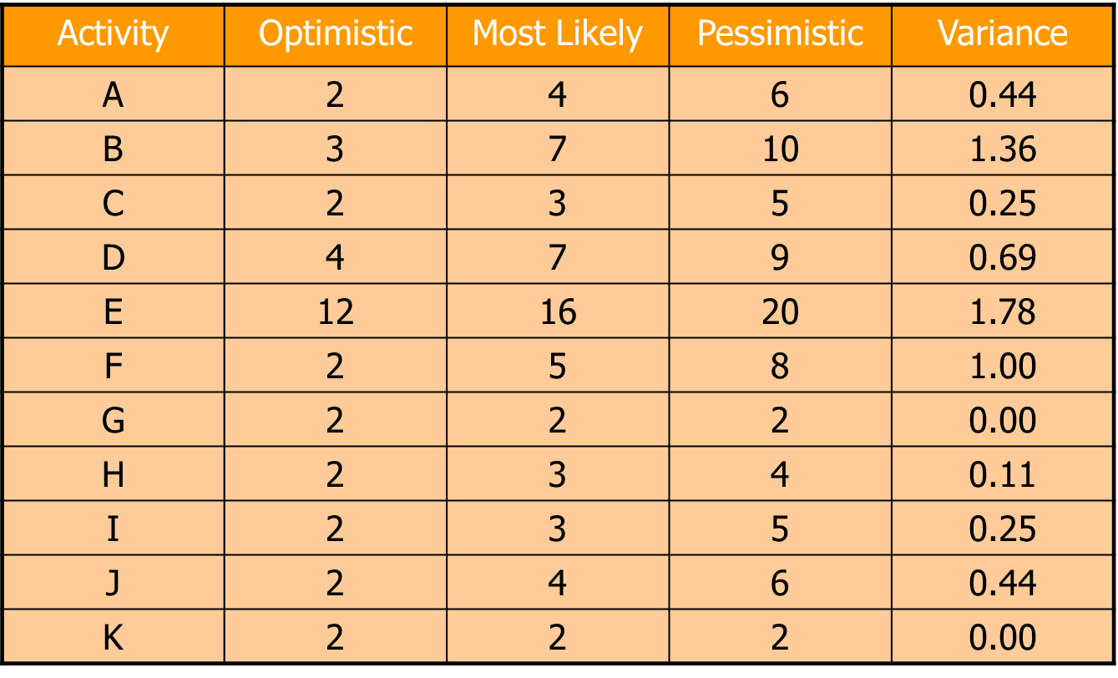
Project Activity Variance

Slide 109
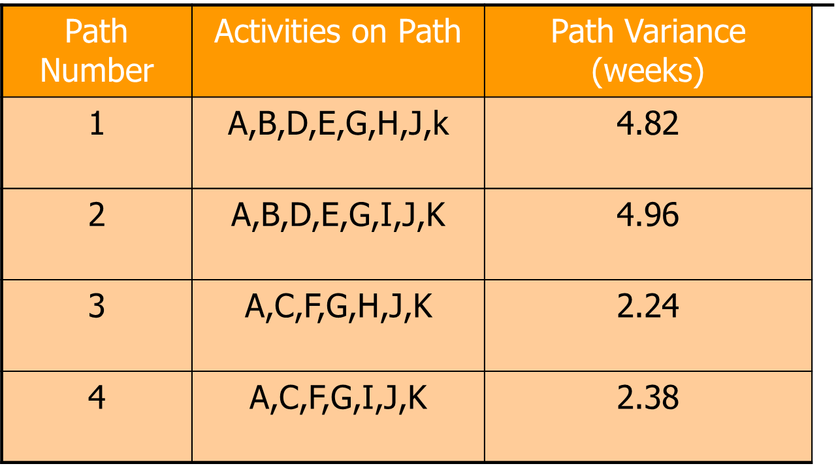
Variances of Each Path through the Network

Slide 110
Calculating the Probability of Completing the Project in Less Than a Specified Time
When you know:
The expected completion time
Its variance
You can calculate the probability of completing the project in “X” weeks with the following formula:
Where D_{T} = the specified project completion time
EF_{P} = the expected completion time of the path

Slide 111
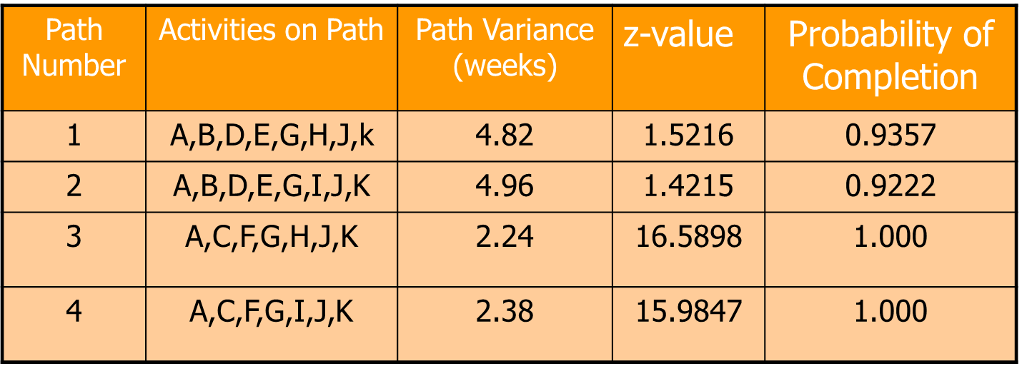
Example: Calculating the probability of finishing the project in 48 weeks
Use the z values in Appendix B to determine probabilities
E.G. for path 1

Slide 112
